Slide 1
Implementing clean architecture using SOLID principle and MVVM
in android development
Presenter: Phạm Ngô Duy Hiếu (Hugh Pham)

Slide 2
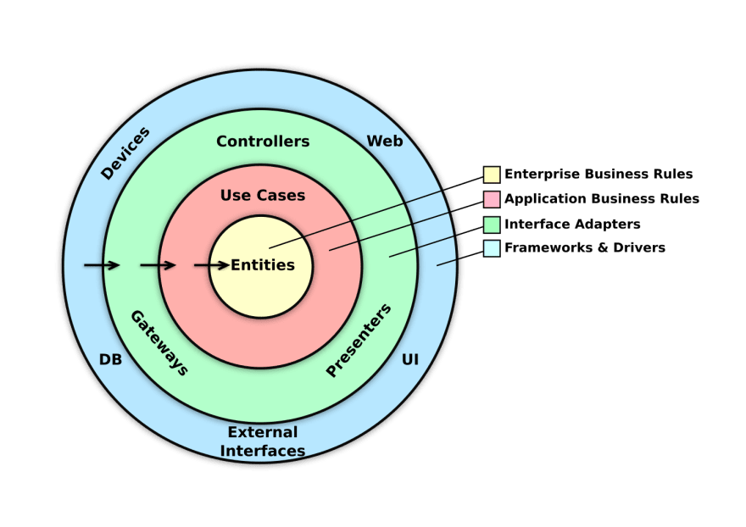
1. The concept of clean architecture
Structuring your code in the form of layers, with each layer having its specific purpose
The outer layers will depend on the inner layers
The outermost layers are the ones that change most frequently

Slide 3

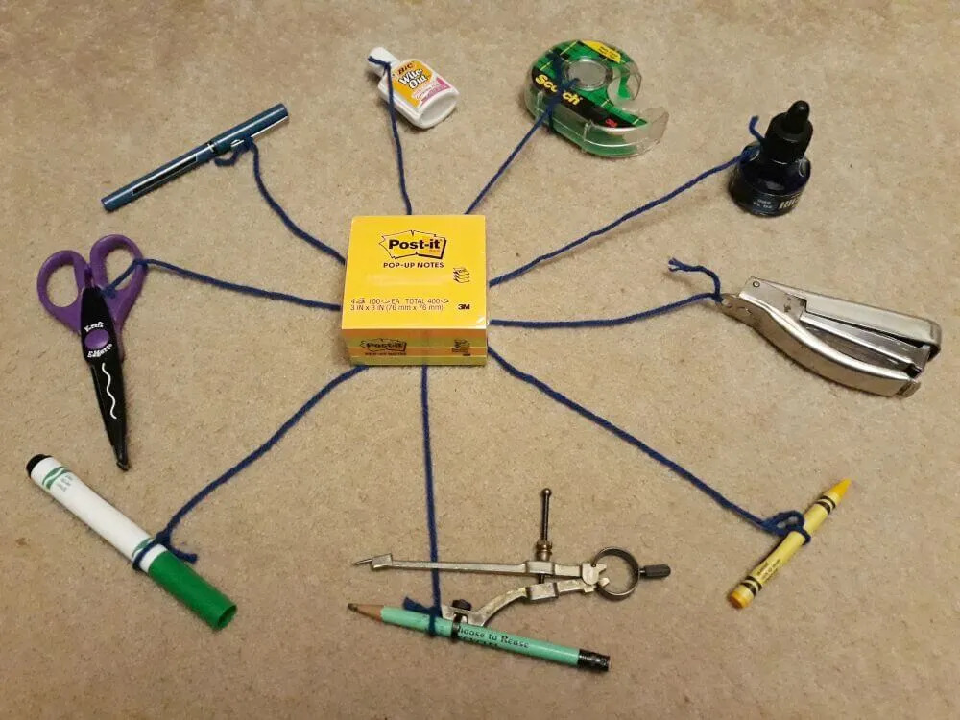
2. Advantages and disadvantages
Before
After

Slide 4
2. Advantages

